Slide 1
Uva 1198
Geodetic Set Problem
Time: 3 seconds

Slide 2

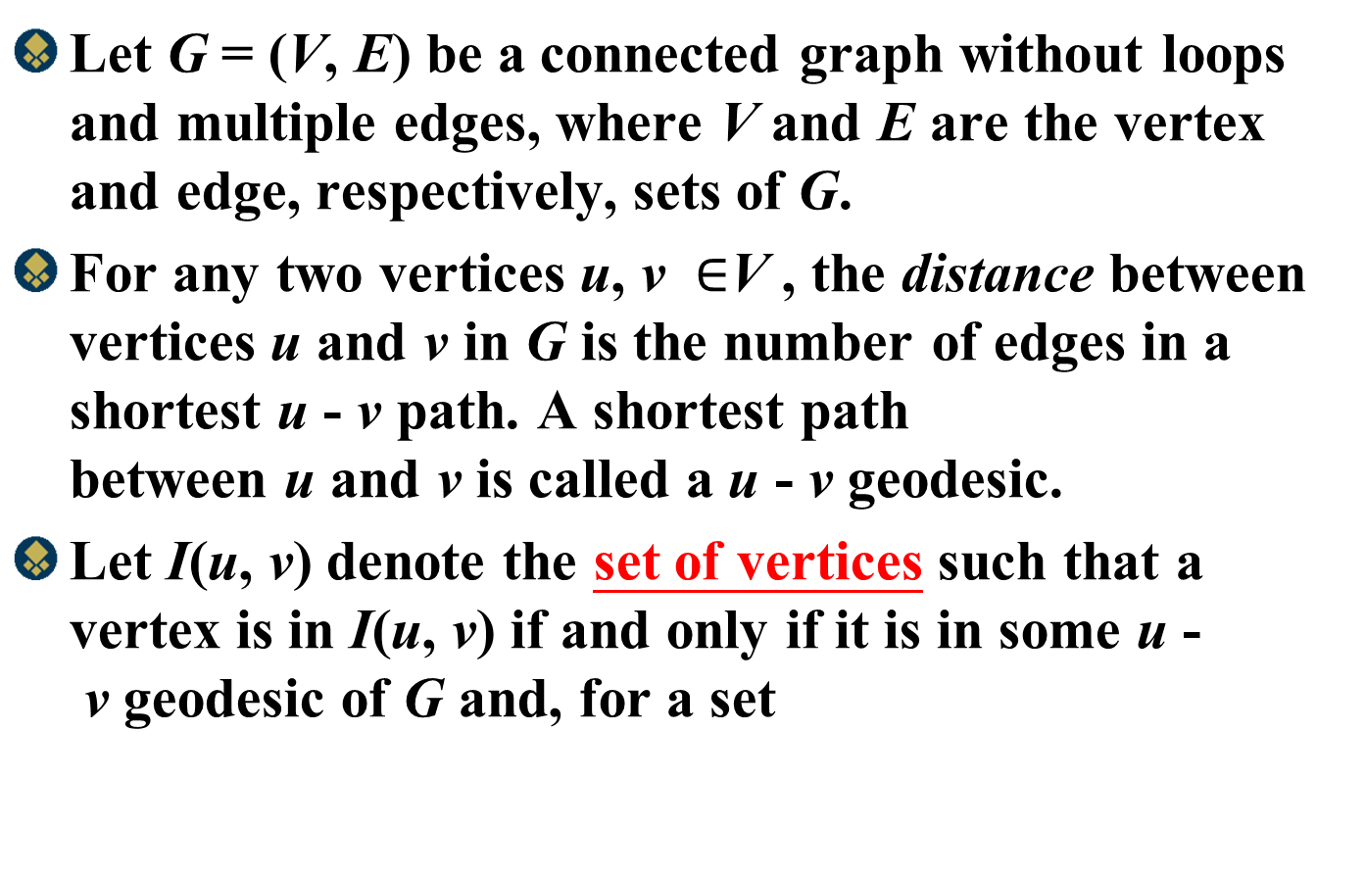
Problem Descriptions(1/3)
Let G = (V, E) be a connected graph without loops and multiple edges, where V and E are the vertex and edge, respectively, sets of G.
For any two vertices u, v $∈$V , the distance between vertices u and v in G is the number of edges in a shortest u - v path. A shortest path between u and v is called a u - v geodesic.
Let I(u, v) denote the set of vertices such that a vertex is in I(u, v) if and only if it is in some u - v geodesic of G and, for a set

Slide 3
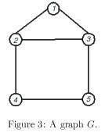
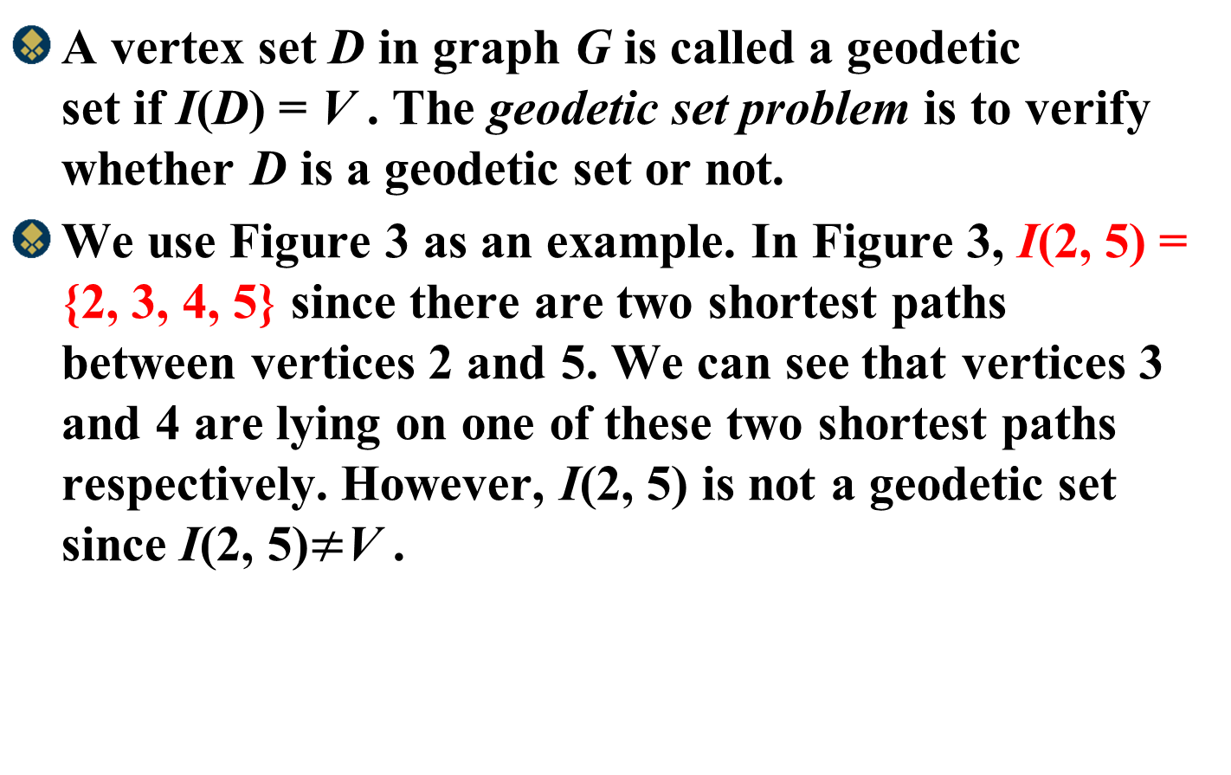
Problem Descriptions(2/3)
A vertex set D in graph G is called a geodetic set if I(D) = V . The geodetic set problem is to verify whether D is a geodetic set or not.
We use Figure 3 as an example. In Figure 3, I(2, 5) = {2, 3, 4, 5} since there are two shortest paths between vertices 2 and 5. We can see that vertices 3 and 4 are lying on one of these two shortest paths respectively. However, I(2, 5) is not a geodetic set since I(2, 5)$≠$V .

Slide 4
Problem Descriptions(3/3)
Vertex set {1, 2, 3, 4, 5} is intuitively a geodetic set of G.
Vertex set D = {1, 2, 5} is also a geodetic set of G since vertex 3 (respectively, vertex 4) is in the shortest path between vertices 1 and 5 (respectively, vertices 2 and 5). Thus, I(D) = V . Besides, vertex sets {1, 3, 4} and {1, 4, 5} are also geodetic sets. However,
D = {3, 4, 5} is not.
??

Slide 5

Input
The input file consists of a given graph and several test cases. The first line contains an integer n indicating the number of vertices in the given graph, where 2$≤$ n $≤$40. The vertices of a graph are labeled from 1 to n. Each vertex has a distinct label.

Slide 6
Input
The following n lines represent the adjacent vertices of vertex i, i = 1, 2,..., n.
For example, the second line of the sample input indicates that vertex 1 is adjacent with vertices 2 and 3. Note that any two integers in each line are separated by at least one space.
After these n lines, there is a line which contains the number of test cases. Each test case is shown in one line and represents a given subset D of vertices. You have to determine whether D is a geodetic set or not.

Slide 7
Output
For each test case, output `yes' in one line if it is a geodetic set or `no' otherwise.

Slide 8
Sample Input / Output
Input
5
2 3
1 3 4
1 2 5
2 5
3 4
6
1 2 3 4 5
1 2 5
2 4
1 3 4
1 4 5
3 4 5
Output
yes
yes
no
yes
yes
no
Number of nodes
Which nodes connect to node 1?
1
Number of test cases
2
3
4
5

Slide 9
All-Pair Shortest Paths Algorithm
Given a weighted, directed graph G=(V, E), we want to compute the shortest paths from u to v for all vertex pairs

Slide 10
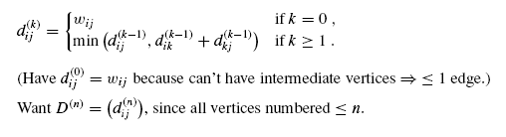
Floyd-Warshall Algorithm
Let d ^{(k)}_{i j} = shortest-path weight of any path i j with all intermediate vertices in {1, 2, . . . , k}

Slide 11
1
6
3
4
11
2
2
3
(1,2)
(1,3)
D⁽⁰⁾ | 1 | 2 | 3
1 | 0 | 4 | 11
2 | 6 | 0 | 2
3 | 3 | ∞ | 0
D⁽¹⁾ | 1 | 2 | 3
1 | 0 | 4 | 11
2 | 6 | 0 | 2
3 | 3 | 7 | 0
(2,1)
(2,3)
(3,1)
(3,2)

Slide 12
1
6
3
4
11
2
2
3
(1,2)
D⁽¹⁾ | 1 | 2 | 3
1 | 0 | 4 | 11
2 | 6 | 0 | 2
3 | 3 | 7 | 0
D⁽²⁾ | 1 | 2 | 3
1 | 0 | 4 | 6
2 | 6 | 0 | 2
3 | 3 | 7 | 0
(1,3)
(2,1)
(2,3)
(3,1)
(3,2)

Slide 13
1
6
3
4
11
2
2
3
(1,2)
D⁽²⁾ | 1 | 2 | 3
1 | 0 | 4 | 6
2 | 1 | 0 | 1
3 | 3 | 7 | 0
D⁽³⁾ | 1 | 2 | 3
1 | 0 | 4 | 6
2 | 1 | 0 | 1
3 | 3 | 7 | 0
(1,3)
(2,1)
(2,3)
(3,1)
(3,2)

Slide 14
Example
1 2 3 4 5
1
2
3
4
5

Slide 15
Example
d⁽¹⁾₄₂ =min {d⁽⁰⁾_{42,}d⁽⁰⁾₄₁ + d⁽⁰⁾₁₂}
d⁽⁰⁾₁₂
1 2 3 4 5
1 2 3 4 5
1
2
3
4
5
1
2
3
4
5
d⁽⁰⁾₄₁
d⁽⁰⁾₄₂

Slide 16
Example
1 2 3 4 5
1 2 3 4 5
1
2
3
4
5
1
2
3
4
5

Slide 17
1 2 3 4 5
1 2 3 4 5
1
2
3
4
5
1
2
3
4
5

Slide 18
1 2 3 4 5
1 2 3 4 5
1
2
3
4
5
1
2
3
4
5

Slide 19
1 2 3 4 5
1
2
3
4
5
5

